Slide 1
Flip Flop

Slide 2
Latch
A Latch is an electronic device that instantly changes its output based on the applied input. We use latch to store either 0 or 1 at any specified time.
The "SET" and "RESET" are two inputs in a latch, and there are two outputs that are complement to each other. We use latch to store one bit of data and it is a memory device.
A latch is just like a flip-flop, but latch is not a synchronous device. The Latch does not work on the clock edges like the flipflop.

Slide 3
Flip-Flop
Flip-flop is a digital memory circuit, and with the help of the flip-flop we can store one bit of information. The fundamental blocks of various sequential circuits are flip-flops. Flip-flop is also called a bistable multivibrator or one-bit or binary. In a sequential circuit, we use flip-flops as a memory element.
In a sequential circuit, the output is obtained from the combinational circuit or flip-flop or both. When the clock pulse is active, then the state of the flip-flop is active, and when the clock pulse is not active, then the state of the clock pulse remains unaffected.
Mainly, in the synchronous sequential circuit, flip flops function as a memory element, and in asynchronous sequential circuit, the un-clocked flip flops or latches function as a memory element.

Slide 4
Types
Set-Reset (SR) Flip-Flop
JK Flip-Flop
D (Data or Delay) Flip-Flop
T (Toggle) Flip-Flop

Slide 5
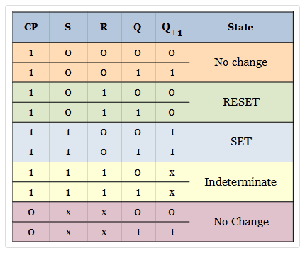
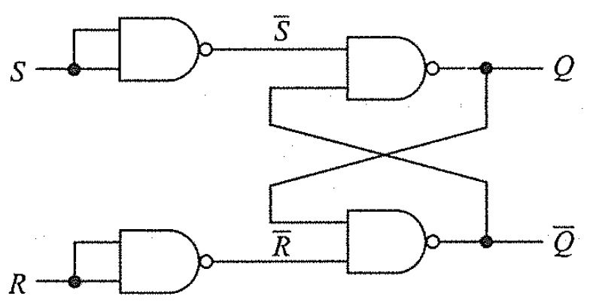
S-R Flip Flop
The SR flip flop is a 1-bit memory bistable device having two inputs, i.e., SET and RESET.
The SET input 'S' set the device or produce the output 1, and the RESET input 'R' reset the device or produce the output 0.
The SET and RESET inputs are labeled as S and R, respectively.

Slide 6
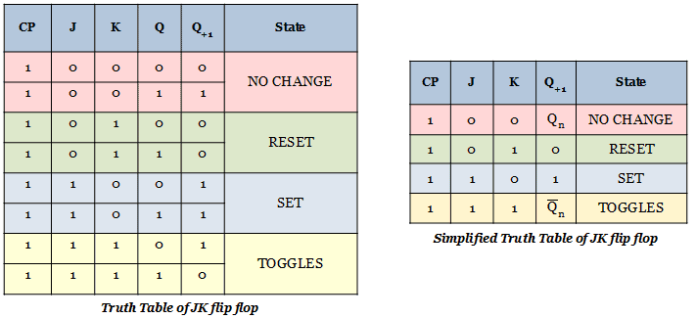
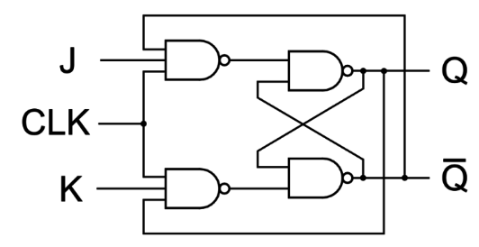
J-K Flip Flop
The JK flip flop work in the same way as the SR flip flop work. The JK flip flop has 'J' and 'K' flip flop instead of 'S' and 'R'.
The only difference between JK flip flop and SR flip flop is that when both inputs of SR flip flop is set to 1, the circuit produces the invalid states as outputs, but in case of JK flip flop, there are no invalid states even if both 'J' and 'K' flip flops are set to 1. So, the JK flip-flop has four possible input combinations, i.e., 1, 0, "no change" and "toggle".

Slide 7
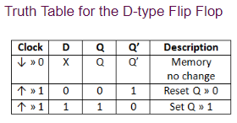
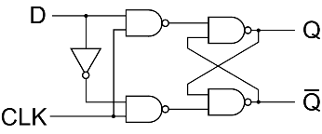
D Flip Flop
In D flip flop, the single input "D" is referred to as the "Data" input. When the data input is set to 1, the flip flop would be set, and when it is set to 0, the flip flop would change and become reset.
However, this would be pointless since the output of the flip flop would always change on every pulse applied to this data input.

Slide 8
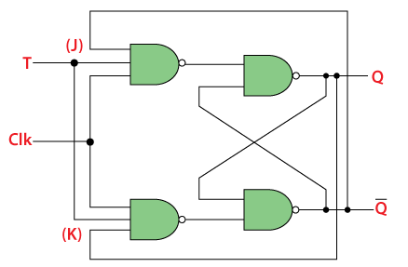
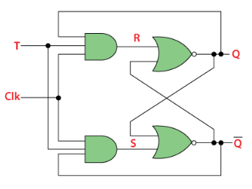
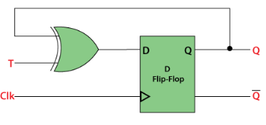
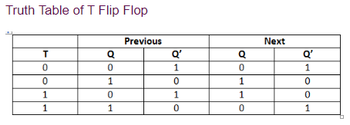
T Flip Flop
In T flip flop, "T" defines the term "Toggle".
We can construct the "T Flip Flop" by making changes in the "JK Flip Flop". The "T Flip Flop" has only one input, which is constructed by connecting the input of JK flip flop.
Similar kind of modification can be done with SR and D also to construct T.
T FlipFlop using JK, SR and T respectively

